Slide 1
Confidential Burgers Inc.
Execution Order Example
Confidential Burgers inc. sells burgers, pizza, and coffee.
Pizza oven
Burger grill
Customer
Waiter
Coffee machine
The waiter (CPU) will
take an order from a customer (CPU instruction)
break the order (instruction) down into micro operations (µOPs - grilling a burger, baking a pizza, …)
schedule and execute the µOPs
complete the order (retire the instruction)
Grand Opening Today

Slide 2

Confidential Burgers Inc. : serial, in order execution
Execution Order Example
Done
Order?
Pizza oven
Burger grill
Customer
Waiter
Coffee machine
Decode instruction into µOPs (“Burger”, “Coffee”)
Schedule µOPs
run 1st µOP (grill the burger)
run 2nd µOP (brew coffee, serial execution)
Retire instruction (customer)
One customer¹ after another (in order)
Each part of the order ² executed serially
I.e. first the burger, then the coffee
PRO: Easy to implement and understand
CON: Slow because resources³ not utilised fully
¹ customer == CPU instruction
² part == µOP - micro operation
³ oven, grill, coffee machine

Slide 3
Confidential Burgers Inc. : Parallel, in order execution
Execution Order Example
Done
Order?
Pizza oven
Burger grill
Customer
Waiter
Coffee machine
One customer¹ after another (in order)
Each part of the order ² executed in parallel
I.e. burger and coffee prepared at the same time
PRO: Faster bc. of better resource utilisation.
CON: Still not perfect, more complex
Decode instruction into µOPs
Schedule µOPs
run 1st µOP and 2nd µOP (parallel execution of µOPs)
retire instruction (customer)

Slide 4


Confidential Burgers Inc. : Parallel, Out of order execution
Execution Order Example
Order?
Your Order ID: #4711
#4711 Done
Pizza oven
Burger grill
Customer
Waiter
Coffee machine
Multiple customers’ orders executed in parallel¹ and delivered (retired) in order
I.e. multiple orders prepared at the same time
PRO: Faster because resources are utilised even better
CON: More difficult to implement
#4711
¹ this is called superscalar

Slide 5
Confidential Burgers Inc.
Execution Order Example
Instruction
CPU core
Adding more resources increase parallelism & throughput.
This is all on one CPU core.

Slide 6
Confidential Burgers Inc. : Order is important
Execution Order Example
Instruction
CPU core
The green instruction will finish before the red instruction.
The CPU ensures that red is seen before green.
Actual µOP execution order
Instruction execution order as seen

Slide 7
Summary
The Pre-execution code lines use the same hardware such as cache.
During the order execution, we can not calculate the conditions.
We do not know the condition, so we perform an unallowed operations using side-channel attack.

Slide 8

Meltdown
Out of order execution

Slide 9
Meltdown
Out of order execution
Meltdown basically works like this:
READ secret from forbidden address
Stash away secret before CPU detects wrongdoing
Retrieve secret

Slide 10

Meltdown: Stashing away - Sidechannel
Out of order execution
Value
address
Read
value at address
RAM
value
…
CPU core
100ns
RAM
Data is stored in RAM
RAM is very slow
Reading one byte stalls the CPU for hundreds of µOPs

Slide 11
Meltdown: Stashing away - Sidechannel
Meltdown & Spectre for normal people
Read
Read
Read
RAM
Cache
Value
Cache
In cache
Not in cache
Value (in Cache)
103ns
100ns
…
CPU core
3ns
Cache
Reading one byte stalls the CPU for hundreds of µOPs
CPU caches considerably speed this up
E.g. reading cached takes 3ns, reading uncached 103ns
RAM
The cache speeds up “what is the value at address X?”. This is called “(address) X is cached”

Slide 12
“READ” Instruction
Meltdown & Spectre
For a CPU the “READ value from memory at 4711”
instruction looks like this (µOPs):
Check that program may read from address
Store the value at address in register¹
1
2
If fails the program is aborted.
This can be handled by the program.
1
In our burger example:
Customer orders a burger & coffee
Burger is ready, coffee machine breaks
Customer does not get his burger
¹ Register: The CPUs scratchpad

Slide 13
Meltdown: READING FORBIDDEN DATA
Meltdown & Spectre
Meltdown basically works like this:
READ secret from forbidden address
Check that program may read from address
Store the read value in register
Stash away secret
Magic
Retrieve secret (later)
1
2
1
1
2
1
µOPs:

Slide 14
Meltdown: READING FORBIDDEN DATA
Meltdown & Spectre
µOPs ordered by instruction
µOPs ordered by execution
1
2
Check access
Read into register
2
1
Read into register
Magic
1
1
Magic
Check access
The re-ordering on the right happens, when the “forbidden data” is already cached (because cache access is so fast).
Reordering is not a problem because the CPU will ensure that is only seen iff succeeds.
Unless is able to hide the secret in such a way that the attacker can find it later.
In our burger example:
Customer orders a burger & coffee
Customer gets his burger
Coffee machine breaks
Customer runs away with burger

Slide 15
Meltdown
Meltdown & Spectre
For Meltdown two actors are needed
The spy and a collector.
The spy will “steal” the secret and stash it away. The CPU will kill him for accessing the secret information.
The collector will find the stashed away secret.
110011010 010111010 111100100 000101101 100110010
110011010 010111010 111100100 000101101 100110010
Spy
Collector

Slide 16
Meltdown: The Sidechannel (Idea)
Meltdown & Spectre
110011010 010111010 111100100 000101101 100110010
…
“It’s a 1”
“It’s a 1”
“It’s a 2”
“It’s a 2”
Spy
110011010 010111010 111100100 000101101 100110010
“It’s a 3”
…
Secret (“3”)
Places
Collector
Spy will read the secret
Depending on the value, Spy will mark a grey block
CPU detects Spys access validation and terminates Spy
Collector now looks for Spys mark in all grey blocks

Slide 17
Meltdown: The attack
Meltdown & Spectre
grey box: memory block tested by Collector
allowed to read?
110011010 010111010 111100100 000101101 100110010
…
“It’s a 1”
Spy
“It’s a 2”
110011010 010111010 111100100 000101101 100110010
Secret (“3”)
“It’s a 3”
…
Secret (“3”)
Cache
Collector
RAM
Meltdown needs some preconditions
The secret is in the cache (value: 3)
Both Spy and Collector can read grey memory blocks

Slide 18
Meltdown: The attack
Meltdown & Spectre
110011010 010111010 111100100 000101101 100110010
…
“It’s a 1”
“It’s a 1”
read: 103ns (uncached read)
“It’s a 2”
Spy
“It’s a 2”
read: 103ns (uncached read)
110011010 010111010 111100100 000101101 100110010
Secret (“3”)
“It’s a 3”
“It’s a 3”
read: 3ns (cached)
…
Secret (“3”)
Cache
Collector
RAM
2
Spy will read the secret
Depending on the value, Spy will cache a grey block¹
CPU detects Spys access validation and terminates Spy
Collector now reads all grey blocks and stops the time
Block “It’s a 3” will be the block read the fastest
1
¹ Actually Spy will cache the address of block #3 and Collector will read the blocks addresses

Slide 19
Meltdown
Meltdown & Spectre
Meltdown exploits two properties of modern CPUs
Out of order execution of OPs and µOPs
Timing side channels for the cache
This allows an attacker to
Read all memory mapped¹ in a process
This often includes all other processes memory
This does NOT allow reading “outside of a VM²”
¹ Virtual vs. physical memory is a subject for another time ² For fully virtualised VMs

Slide 20
Meltdown Example Code
Meltdown & Spectre
We reset the processor cache
char userspace_array[256*4096]; for (i = 0; i < 256*4096; i++) { _mm_clflush(&userspace_array[i]); }
We read an interesting variable from the address space of the kernel, which will cause an exception, but it will not be processed immediately.
const char* kernel_space_ptr = 0xBAADF00D; char tmp = *kernel_space_ptr;
Speculatively, we do a read from the array, which is located in our user address space, based on the value of the variable from item 2.
char not_used = userspace_array[tmp * 4096];
We consistently read the array and accurately measure the access time. All the elements, except for one, will be read slowly, but the element that corresponds to the value at the address inaccessible to us is fast, because it has already entered the cache.
for (i = 0; i < 256; i++) { if (is_in_cache(userspace_array[i*4096])) { // Got it! *kernel_space_ptr == i }}
Thus, the object of the attack is the microarchitecture of the processor, and the attack itself cannot be repaired in the software.

Slide 21

Spectre
Speculative execution

Slide 22
Confidential Burgers Inc. : Parallel, Out of order execution
Execution Order Example
Order?
Your Order ID: #4711
#4711 Done
Pizza oven
Burger grill
Customer
Waiter
Coffee machine
Multiple customers’ orders executed in parallel¹ and delivered (retired) in order
I.e. multiple orders prepared at the same time
PRO: Faster because resources are utilised even better
CON: More difficult to implement
#4711
¹ this is called superscalar

Slide 23
spectre: Branch prediction
Meltdown & Spectre
Monday
Wednesday
Tuesday
…

Slide 24

spectre
Meltdown & Spectre
Spectre attacks other processes by forcing them to speculatively run other code paths
Victim Process
Attacker Process
A
B
C
D
D
Counter > 0?
E

Slide 25
spectre
Meltdown & Spectre
Spectre works like this:
force victim to leak secret
stash away secret
retrieve secret
and basically work like in Meltdown
works by manipulating the branch prediction of the CPU

Slide 26
spectre: Speculative execution
Meltdown & Spectre
The CPU can improve the coffee machine utilisation by speculatively brewing the coffee for
This is very similar to the effect seen in Meltdown.
In the Meltdown attack the CPU knows the next instruction (order) and asynchronously checks the permissions
In Spectre the CPU guesses the next instructions based on heuristics (brew coffee without knowing the order)

Slide 27
spectre: Speculative execution
Meltdown & Spectre
A
B
3
2
1
1
C
Counter
D
D
Counter > 0?
E
The CPU has learned that Counter probably is > 0
Reading Counter from memory is very slow
The CPU speculatively executes to improve performance
B
C

Slide 28

spectre: Speculative execution
Meltdown & Spectre
Victim Process
Attacker Process
A
0
Prime the branch prediction to expect a loop
Make sure Counter is not cached so the CPU is more likely to speculatively run the code
Find a way that victim leaks data when B & C are executed speculatively
Counter
B
C
D
D
Counter > 0?
E
Attacker can influence the CPUs branch prediction of victim.
Making the victim speculatively execute “wrong” code.
E.g. loop even when Counter is == 0.

Slide 29
spectre: Variant 2 (CVE-2017-5715)
Meltdown & Spectre
A
B
3
2
1
1
C
(3) Jump to indirect address
Counter
D
D
1
B
(1) Counter > 0?
(2) Read next
instruction
address
E
D
The conditional jump (branch) now is an indirect jump.
Indirect jumps use addresses stored "somewhere else”.
This can also be used to speculatively execute any code found in the target process (kernel).

Slide 30
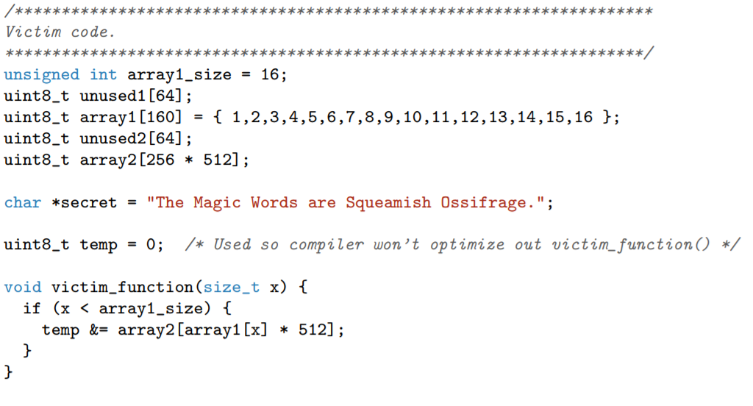
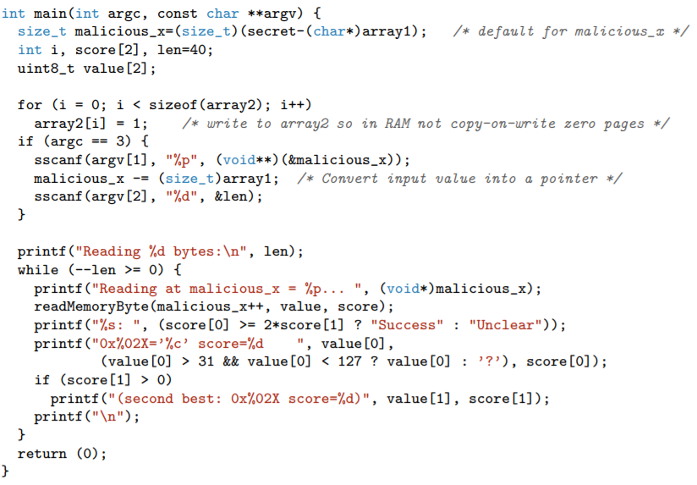
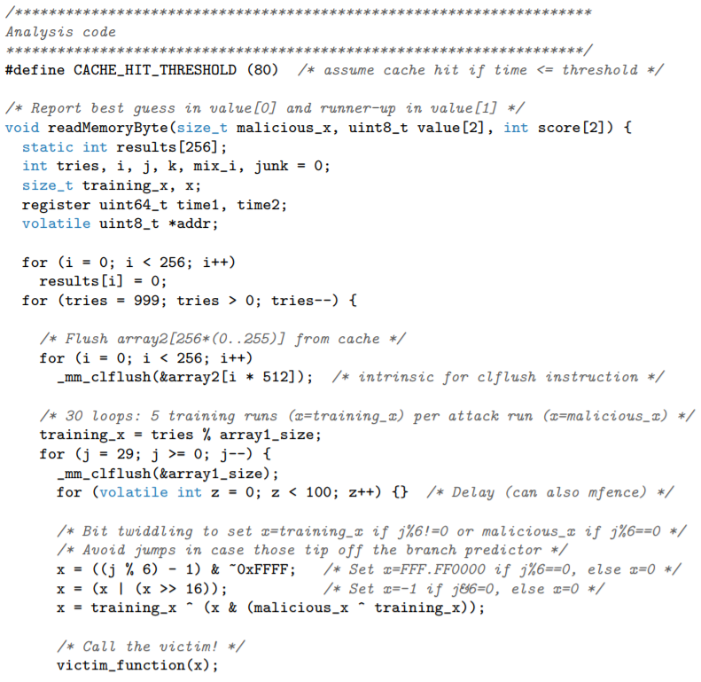
Spectre Code Example
Meltdown & Spectre
Source: https://www.exploit-db.com/docs/english/43426-spectre---trick-error-free-applications-into-giving-up-secret-information.pdf

Slide 31
Slide Source
This presentation is taken from the following source:
https://github.com/neuhalje

